Slide 1

VENDOR REVIEW SYSTEM
GUIDED BY:
Mr.BAJI RAO
DEVELOPED BY:
Shama malik

Slide 2
TABLE OF CONTENTS
Introduction
Aim of the Project
Objective of the Project
Systems Requirements
Technologies Used
Project Modules
Flow of Process and characteristics of all roles
Screenshots
Conclusion

Slide 3
INTRODUCTION
Vendor Review System is the Online Reviewing System that is providing reviews about the products sold out by the vendors by Foodies .
The Purpose of the Project Vendor Review System is to deliver the Quality of the products . By giving the Reviews for the Vendors , foodies can know the Quality of the Products. The Vendor can also raise complaint on the foodies reviews and ratings by that they can prove the quality of their products.
Vendor Review System is a web application which provides a user-friendly user interface and an easy efficient way to giving the reviews and ratings and also raise the complaints.
Vendor Review System which has admin and vendor and foodie models.

Slide 4
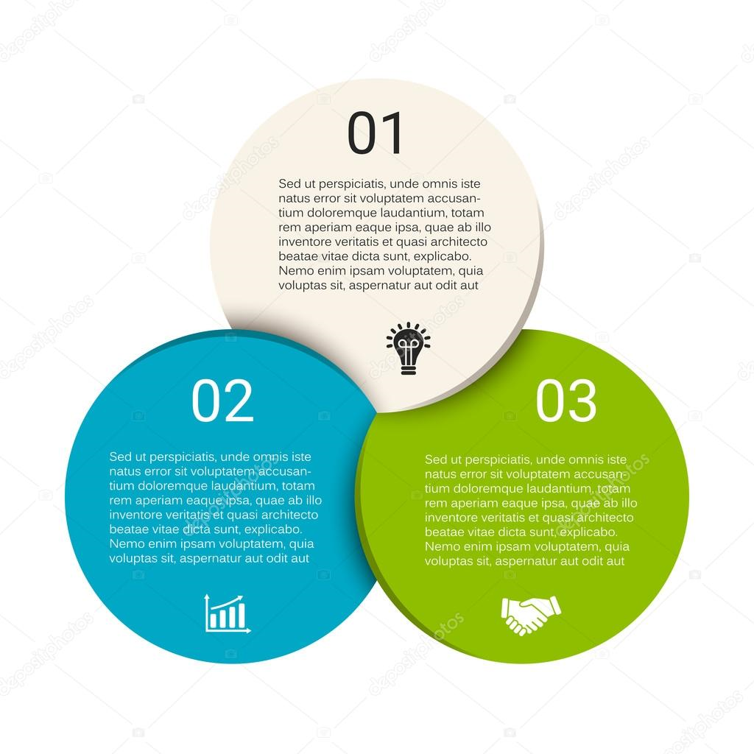
AIM OF THE PROJECT
The Foodie will give the reviews for the products it will determine the Quality of the product.
The Growth of the vendors will increase who are providing the Quality food product.
It is the easy way of online Communication for both vendors and foodies.

Slide 5



Objective of the project
The Admin will Manage the both vendors and foodie details. Admin will view review given by the foodie and complaint raised by the vendors. Finally Admin will generate the report for vendors and foodies.
To login to foodie Portal the users want to register as the foodie and provide the review and rating for the vendors.
To login to vendor Portal the users want to register as the vendor and by seeing the reviews and ratings given by the foodies vendor want to raise the complaints on foodies.

Slide 6
SYSTEM REQUIREMENTS
HARDWARE REQUIREMENTS
SOFTWARE REQUIREMENTS
DISK SPACE : 1 GB ABOVE
RAM : 2GB ABOVE
VISUAL STUDIO 2022
SQL Tool

Slide 7
TECHNOLOGY USED
CSHARP DOTNET
HTML
CSS
BOOTSTRAP
SQL

Slide 8
CONTD..
CSHARP FEATURES :
SQL FEATURES:
Login, Authentication
Vendor Register
Foodie Register
Logout
Admin Dashboard Details
Vendor Dashboard Details
Foodie Dashboard Details
Users Table
Vendors Table
Foodies Table
Foodie Reviews Table
Complaints Table

Slide 9
Project modules
Vendor Registration
Foodie Registration
User Login
Vendor Details
Vendor Request
Foodie Details
Forgot Password
Admin Vendor View Review
Admin View Complaint
Generate Report
Raise Complaint
Foodie Review
Foodie View Review

Slide 10
flow of process and Characteristics of ADMIN
Vendor Request
Vendor Details
Foodie Details
Login
View Review
Logout
View Complaint
Generate Report

Slide 11
Flow of process and characteristics of vendor
Login
View Review
Raise Complaint
Register
Logout

Slide 12
Flow of process and characteristics of foodie
Login
Giving review
Register
View review and edit and delete the review
Logout

Slide 13
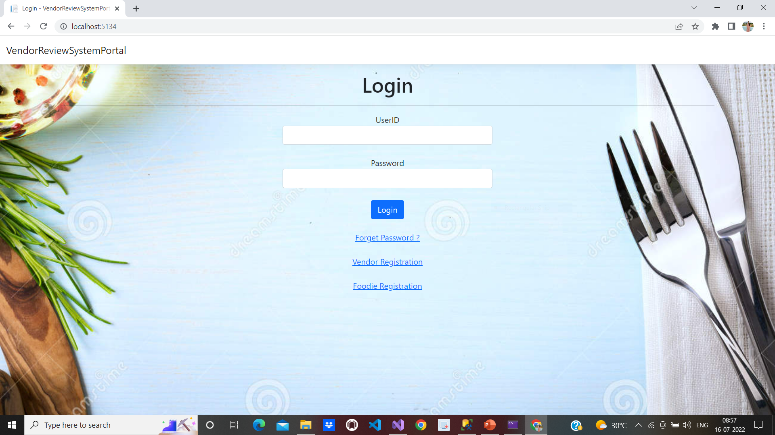
Screenshots Login page

Slide 14
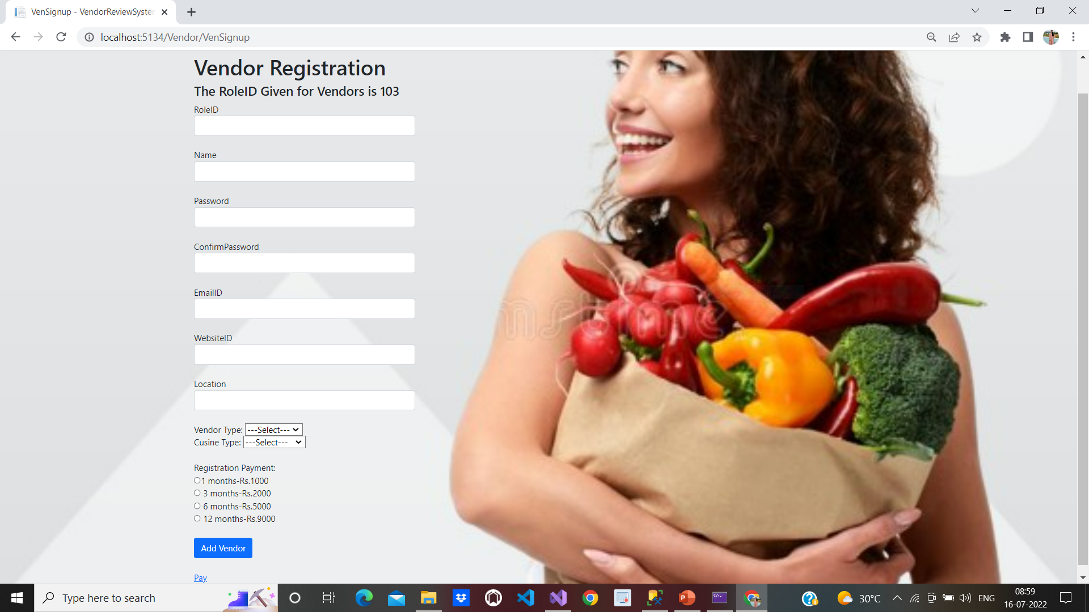
Vendors Registration page

Slide 15
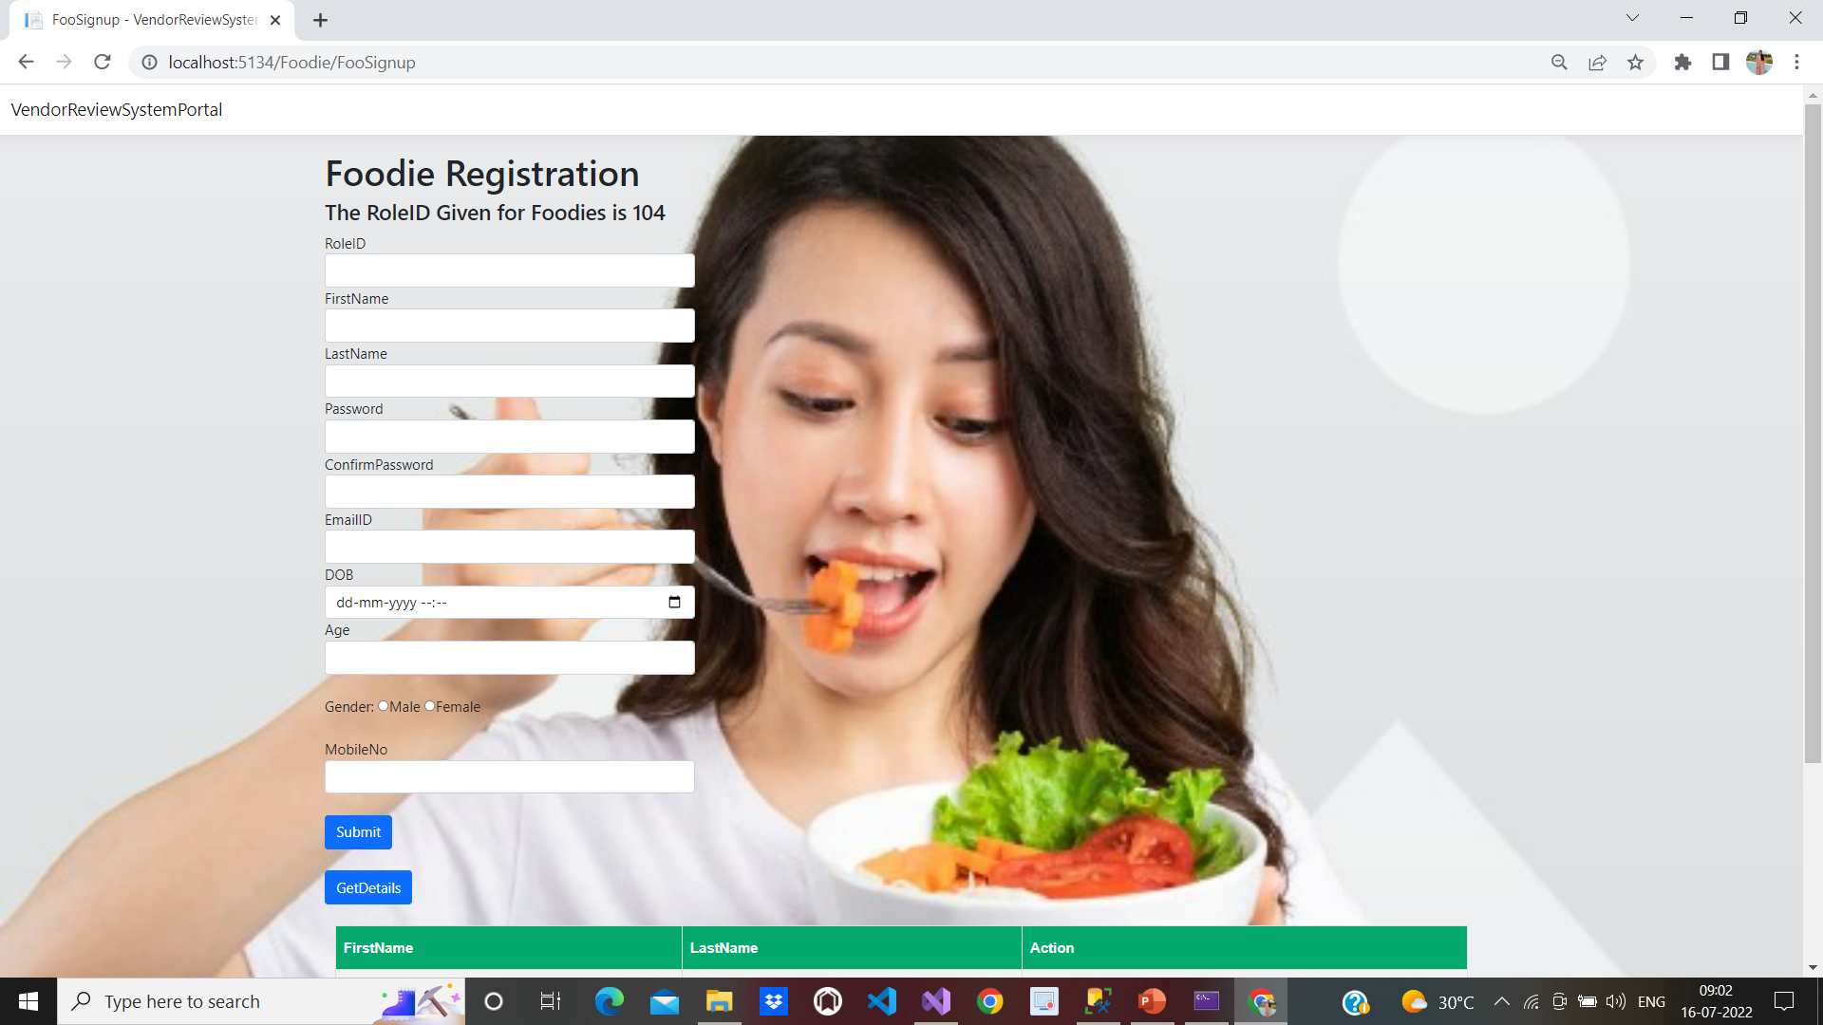
Foodies registration Page

Slide 16
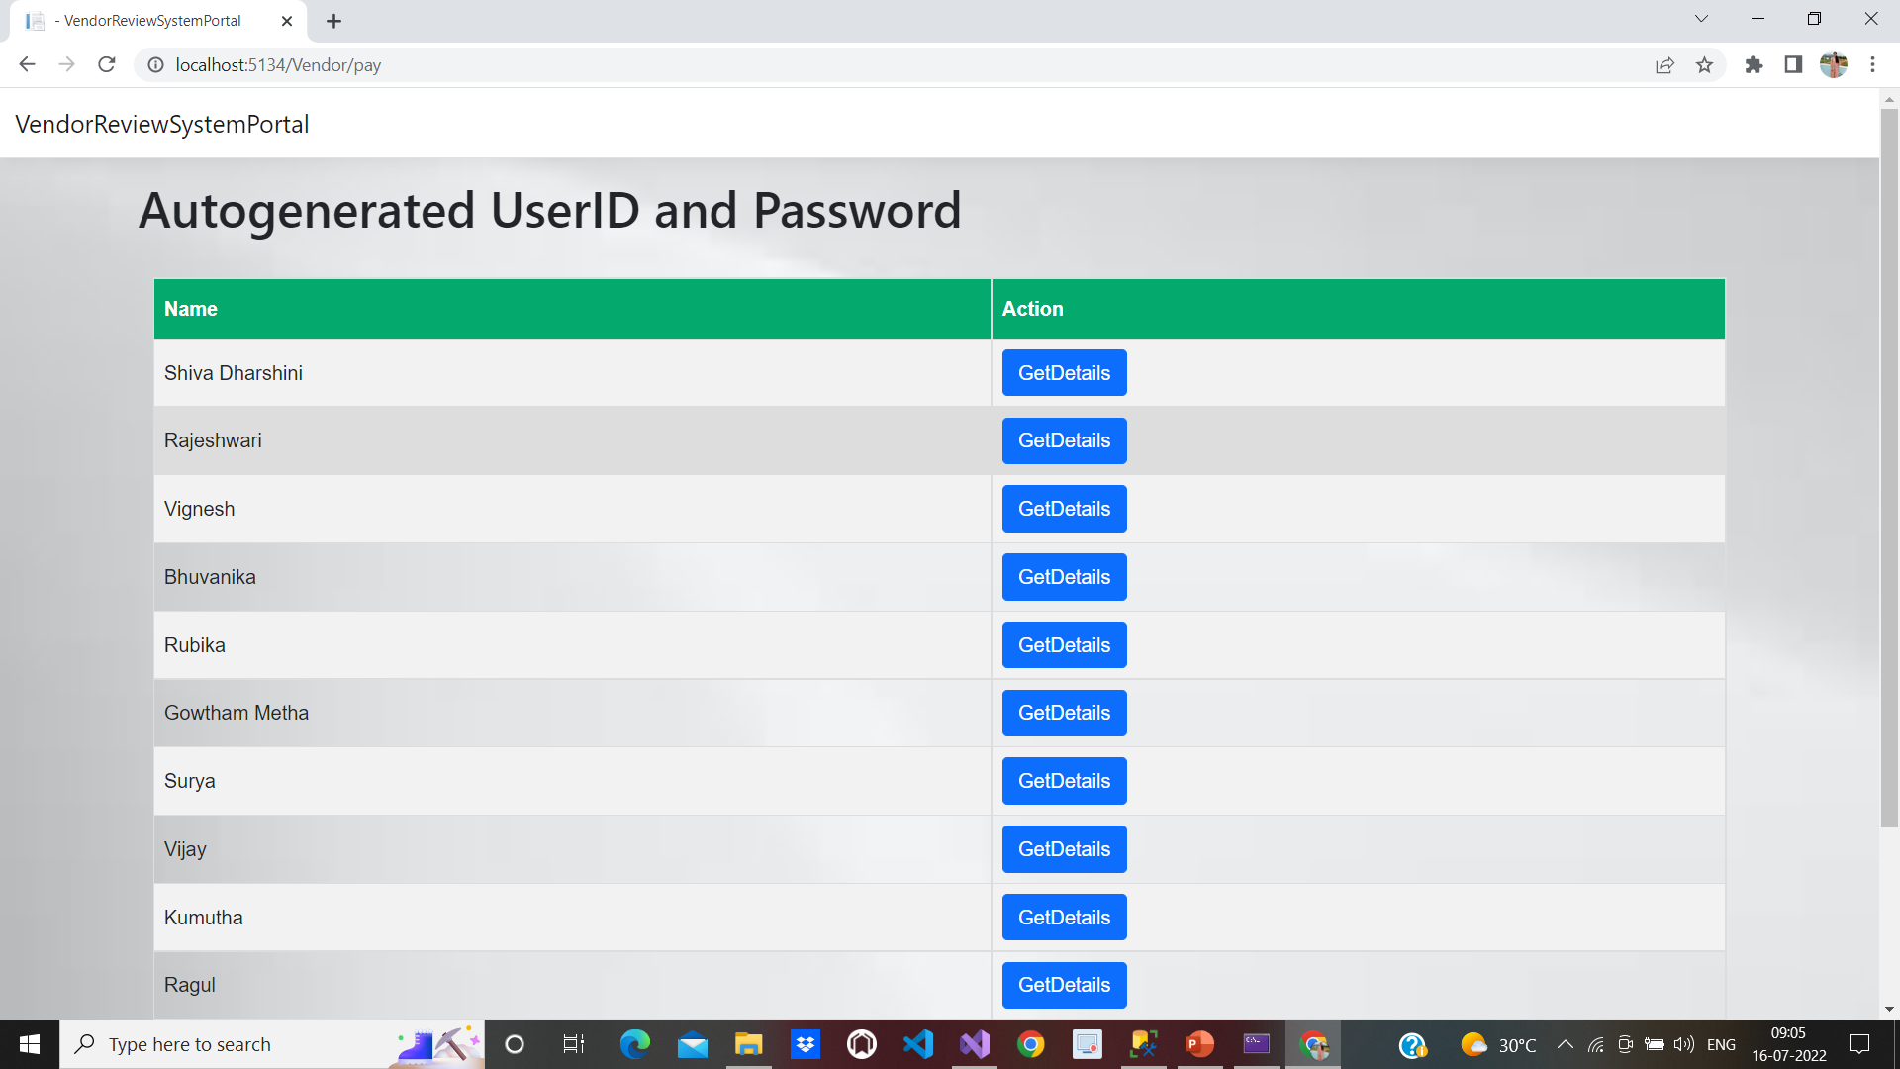
Vendors getting Autogenerated User ID for LOgin

Slide 17
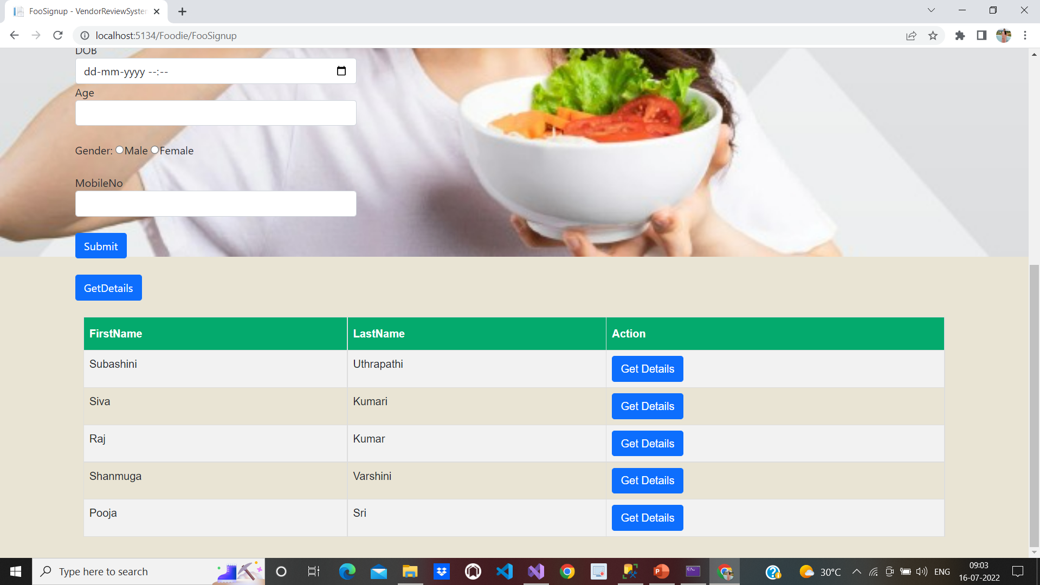
Foodies Getting Autogenerated User ID for Login

Slide 18
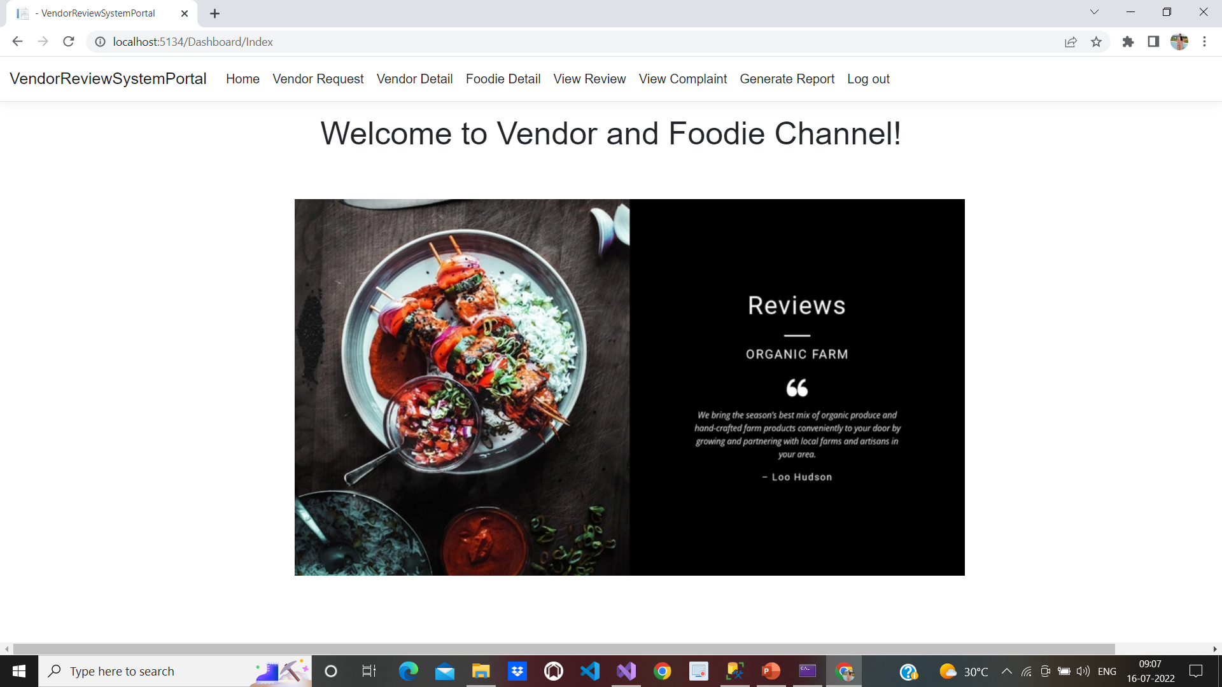
Admin Dashboard

Slide 19
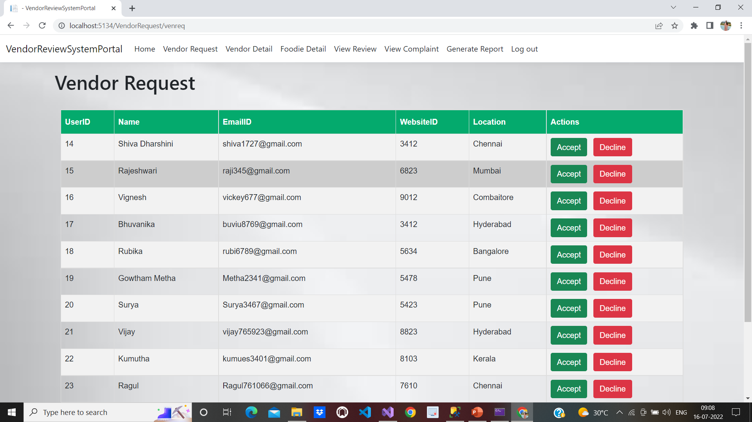
Admin Viewing the Vendor Request Page

Slide 20
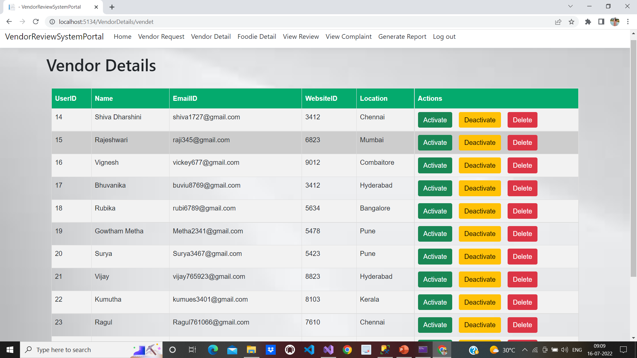
Admin viewing the vendor details Page

Slide 21
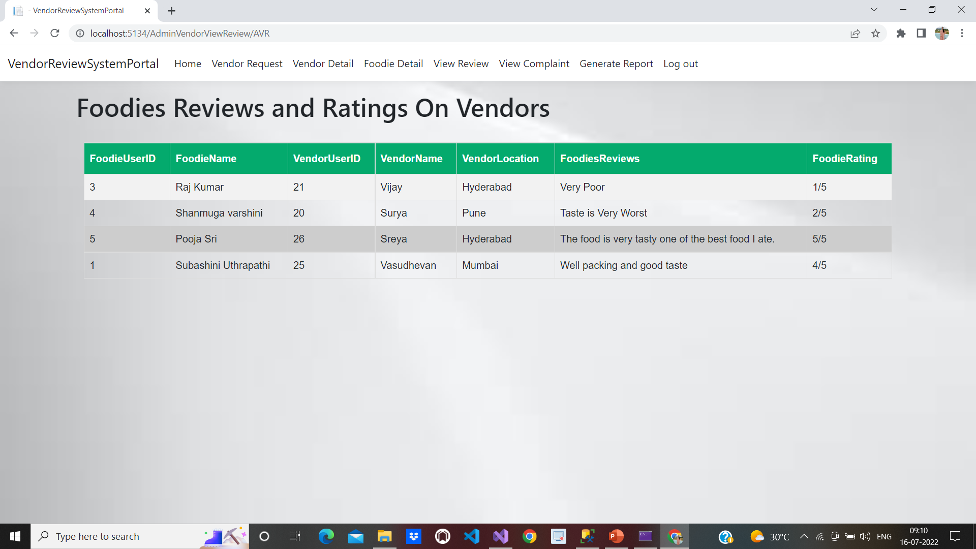
Admin viewing the reviews provided by foodies

Slide 22
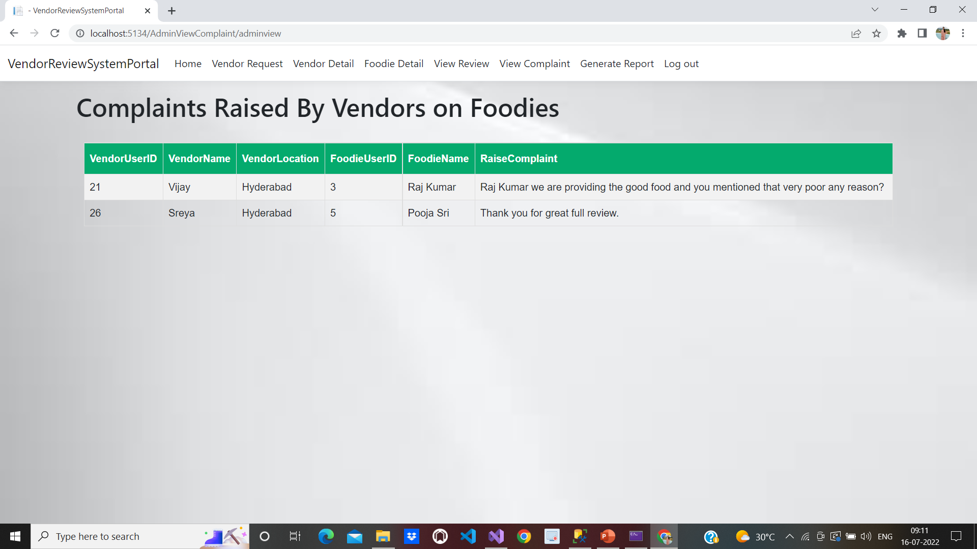
ADMIN VIEWING THE COMPLAINTS RAISED BY VENDORS ON FOODIES

Slide 23
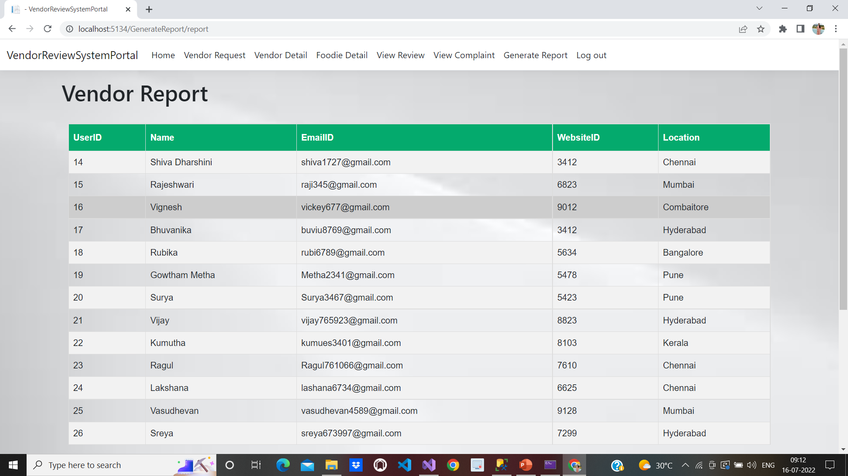
ADMIN GENERATED REPORT FOR VENDORS

Slide 24
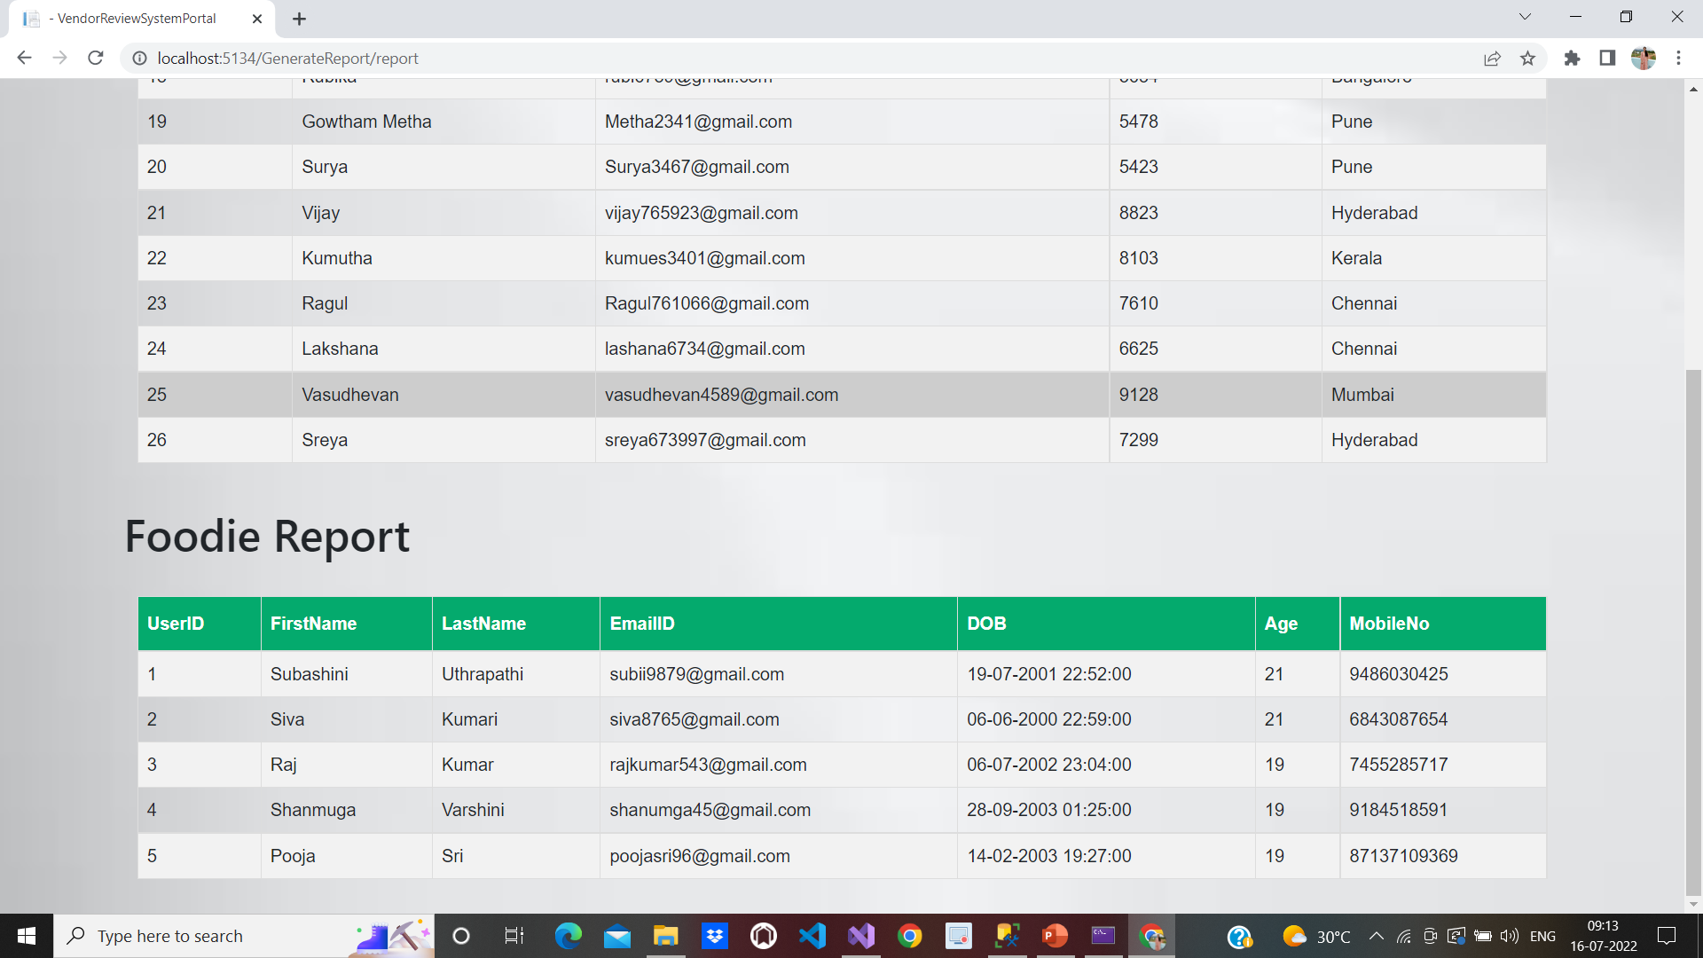
ADMIN GENERATED REPORT FOR FOODIES

Slide 25
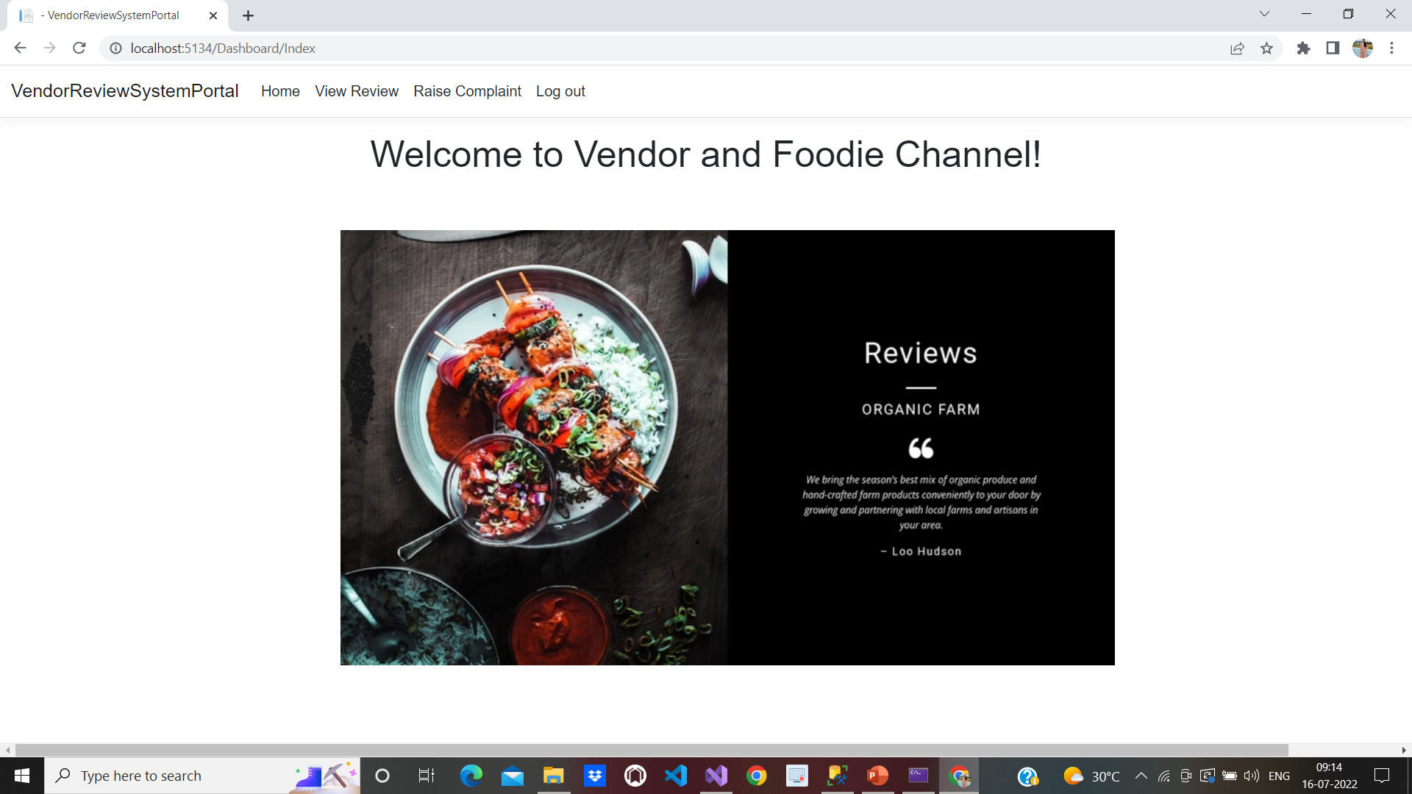
VENDOR DASHBOARD

Slide 26
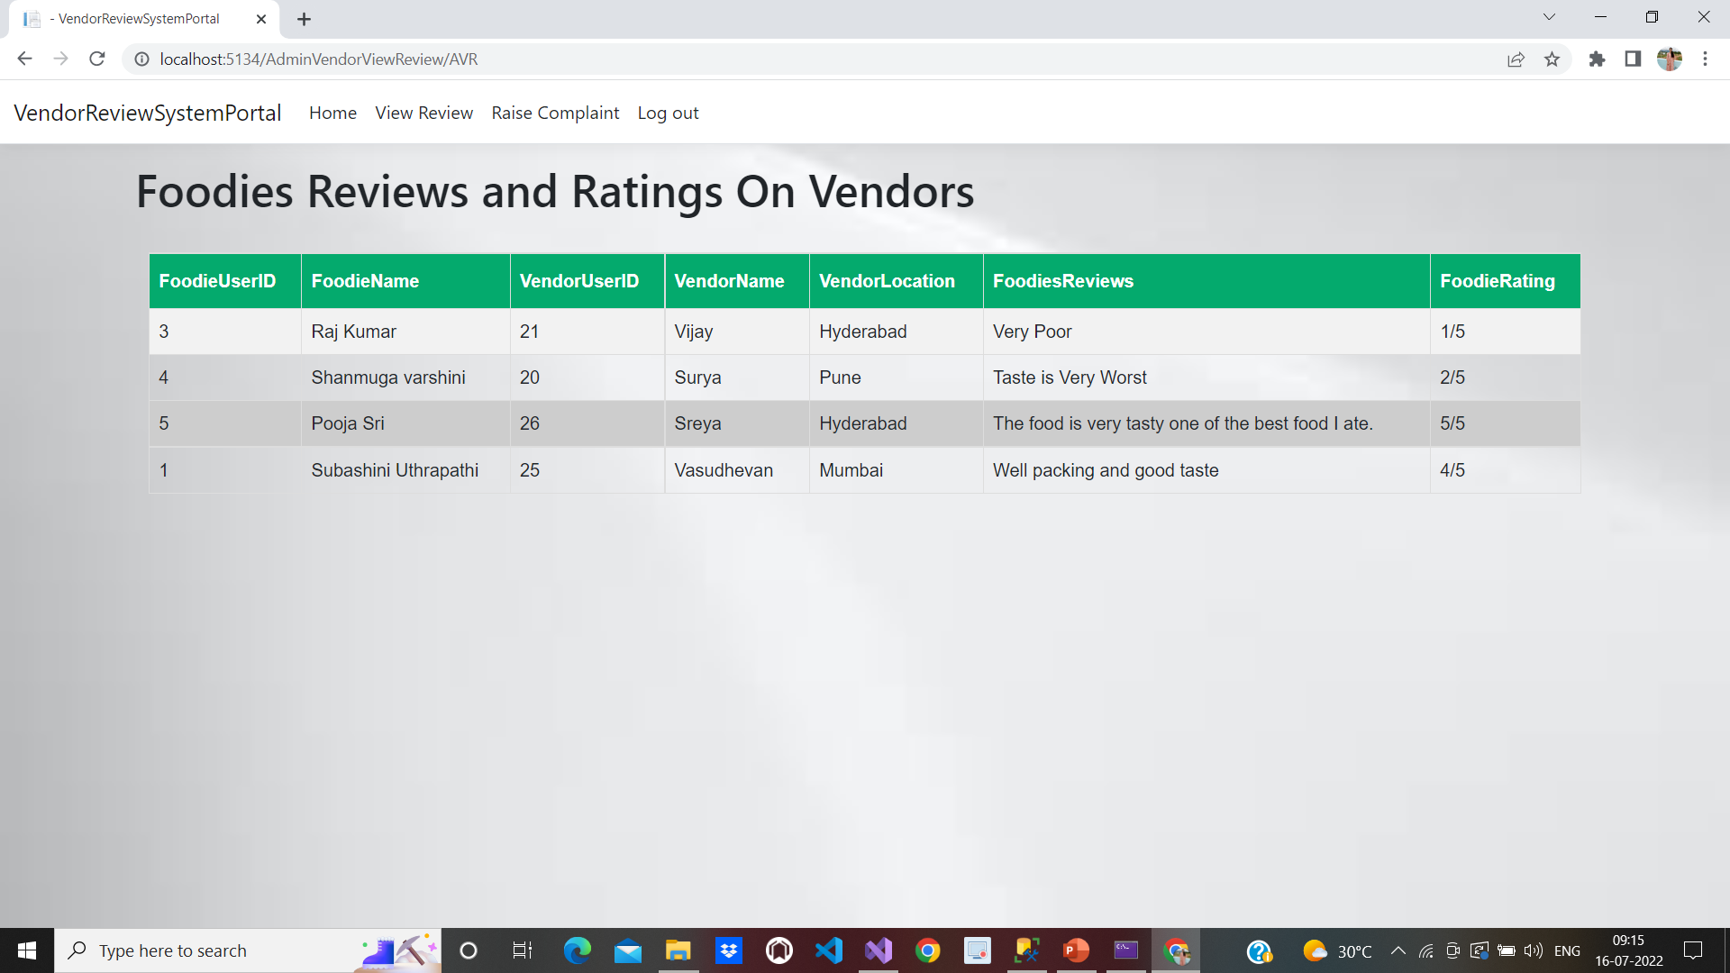
VENDOR VIEWING THE REVIEWS GIVEN BY FOODIES

Slide 27
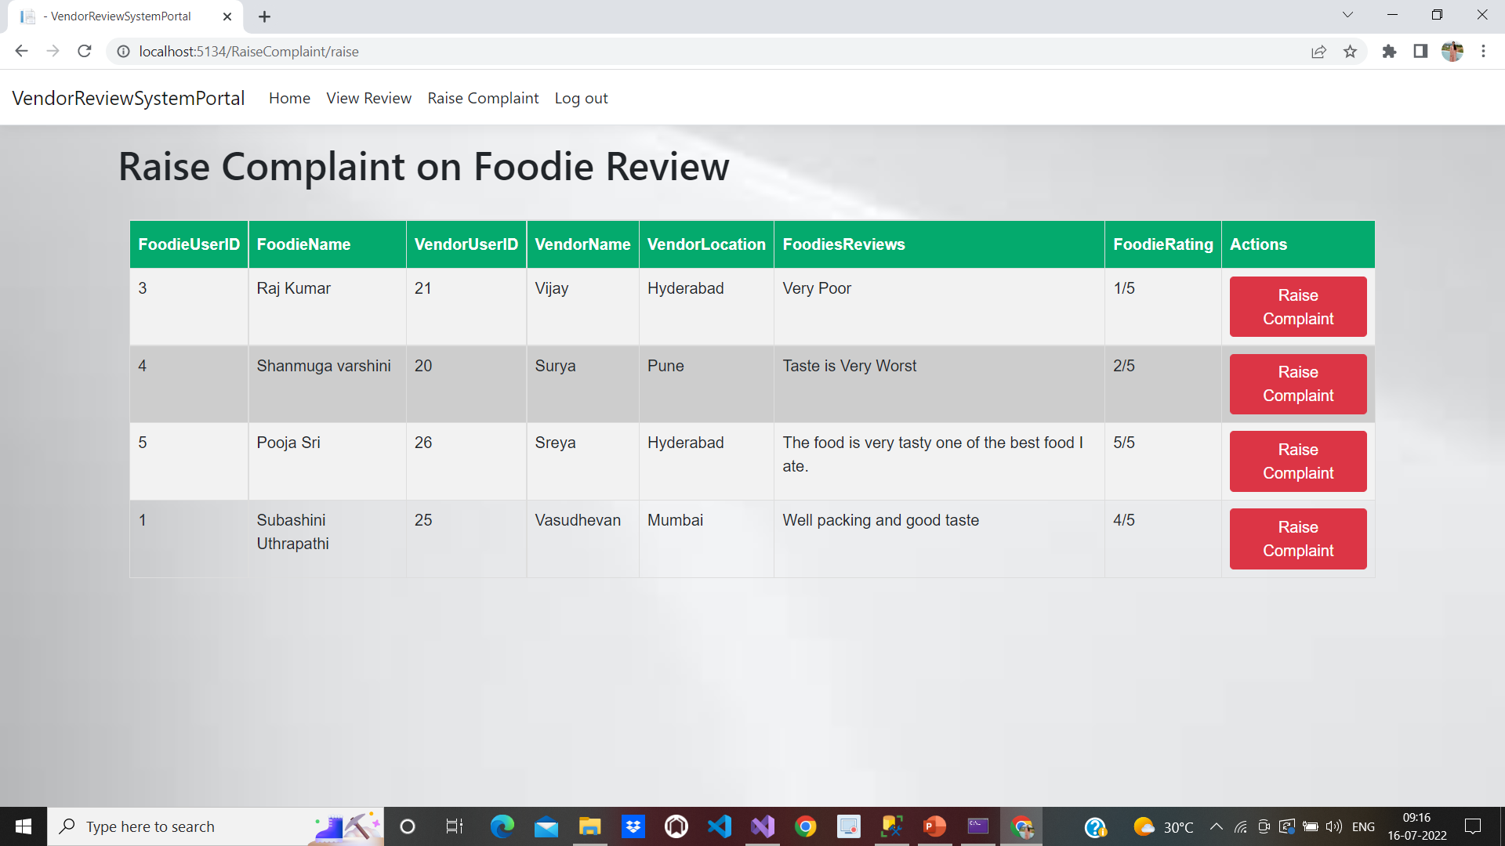
VENDORS RAISE COMPLAINT ON FOODIES REVIEWS

Slide 28
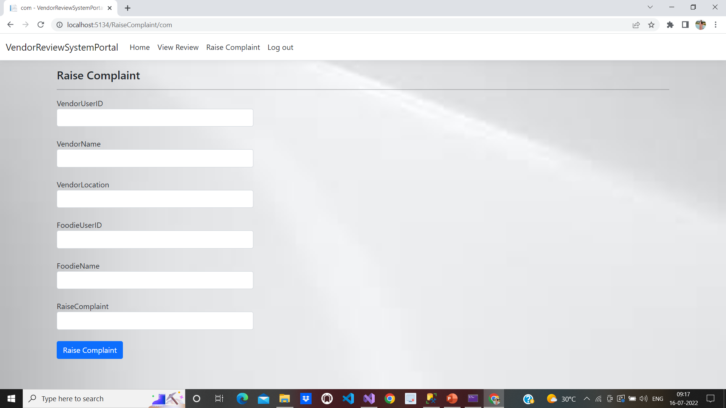
Raise complaint form

Slide 29

Foodie dashboard

Slide 30
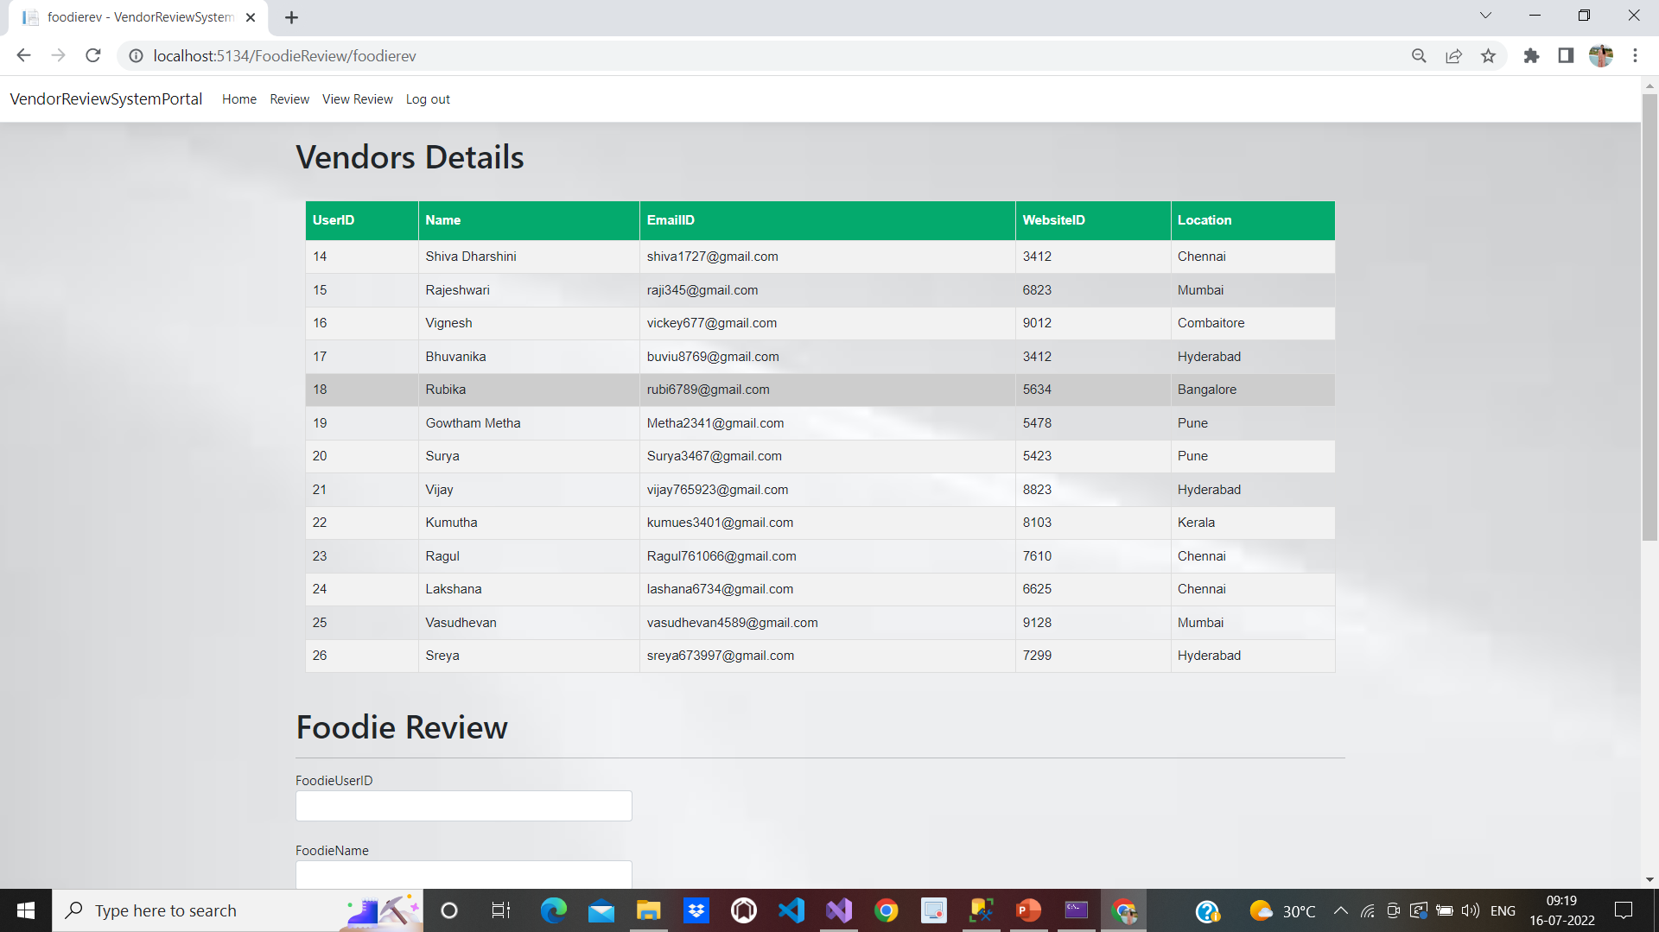
Foodie giving review for the vendors by viewing vendor details

Slide 31
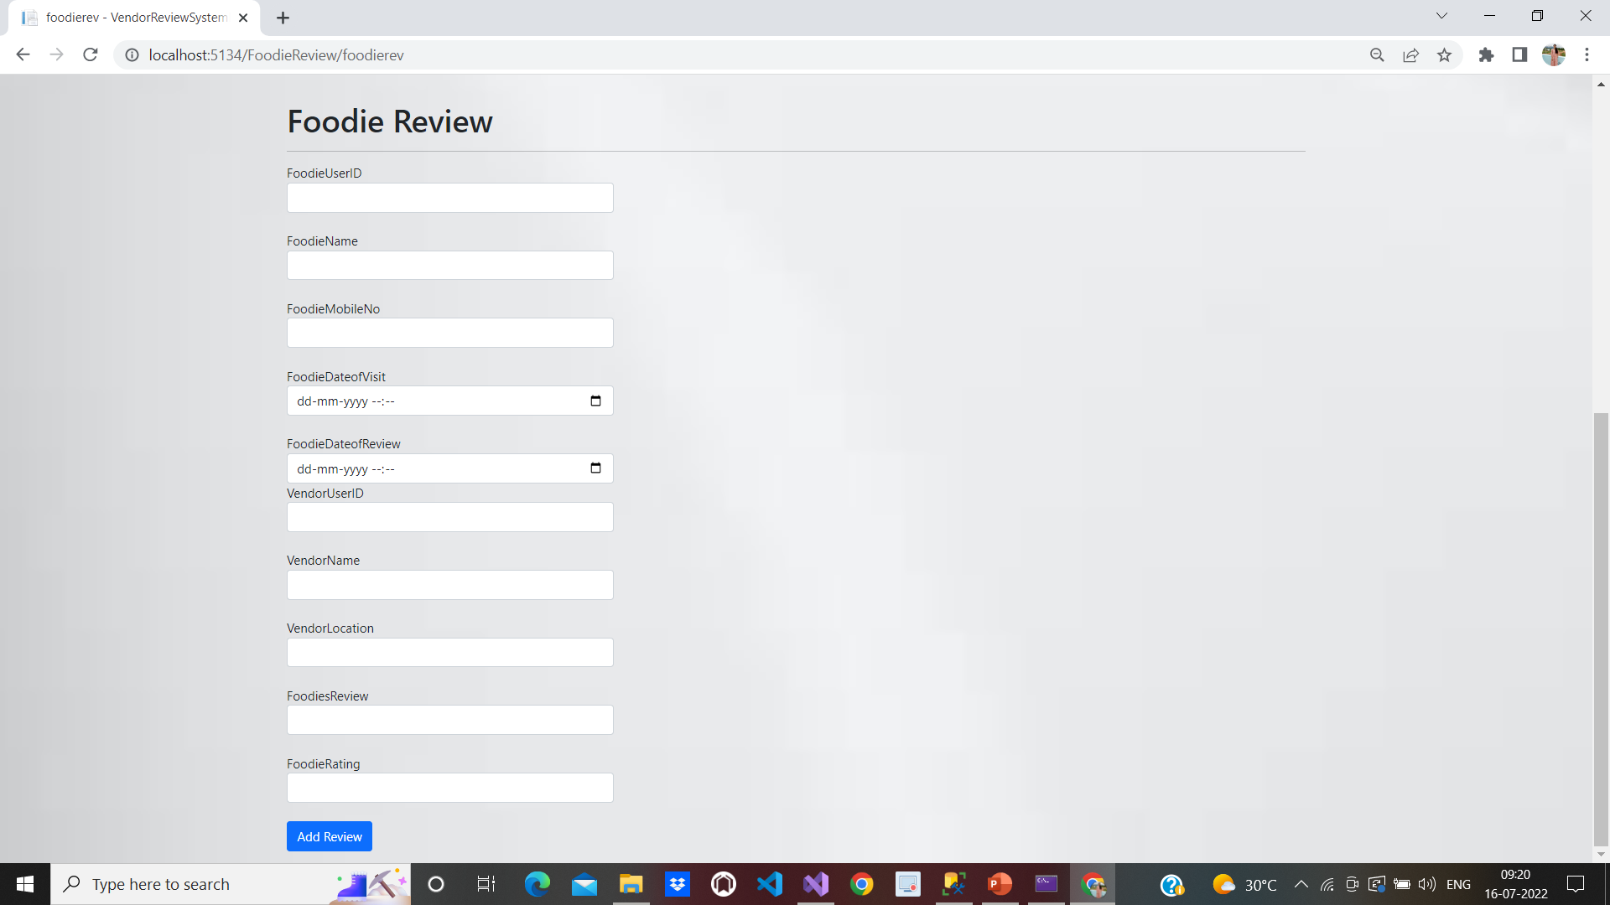
Foodie review form

Slide 32
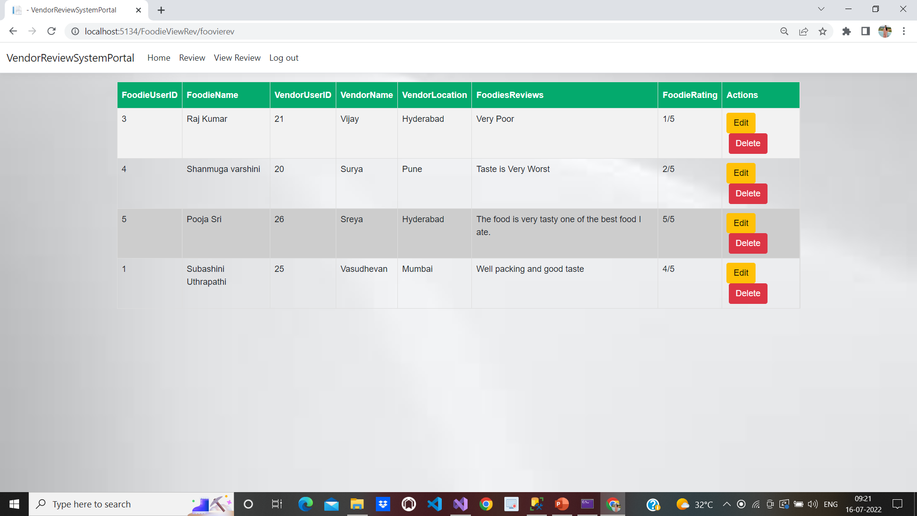
Foodie viewing the review given by them and can edit and delete

Slide 33
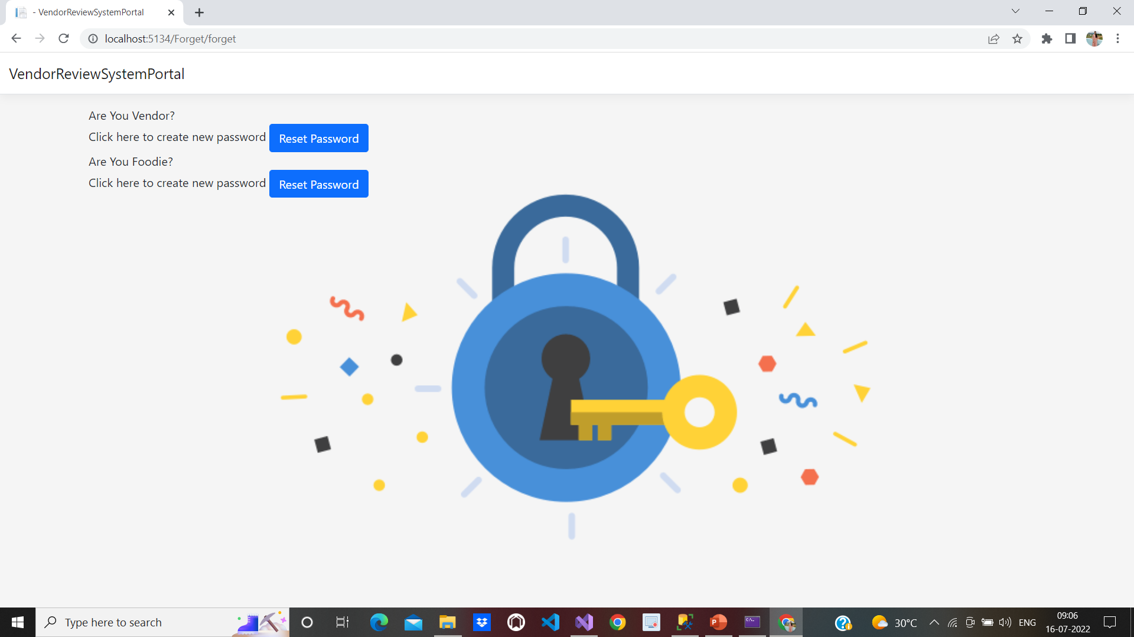
Reset password page

Slide 34
conclusion
The project meets the requirements that foodies will review the vendors and the vendors will raise complaints on foodies and the admin will manage both the vendors and foodies by accepting or decline the newly registered vendors and foodies and generating the report and viewing the reviews and complaints provided by them . This web Application provides the easy way of communication between the vendors and foodies and it is user-friendly.

